Slide 1
NeuroLearn - AI-Powered Adaptive Smart Classroom
Enhancing Learning through Neurotechnology
Presented by:
Sahana. M. D
Shreya. G. Mantha
Sumangala
Mentor: Dr. Basanti. Ghanti
Institution: Sharnbasva University, Kalaburagi

Slide 2
INTRODUCTION
The vision behind NeuroLearn is to cultivate a truly personalized educational ecosystem where every student's unique learning journey is recognized, supported, and optimized.
Traditional educational paradigms, often characterized by a "one-size-fits-all" approach, frequently overlook the vast spectrum of individual learning paces, cognitive styles, and socio-economic disparities.
NeuroLearn directly addresses this critical gap by employing cutting-edge artificial intelligence to dynamically tailor content, pedagogical strategies, and assessment methods.

Slide 3
System overiew
-Technologies used:
1) Backend:
Python Flask
2) Frontend:
HTML5, CSS3, JavaScript (ES6+)
3) AI/ML:
OpenVINO
scikit-learn
NumPy
Pandas
4) Visualization:
Matplotlib
Seaborn:
5) Database
SQLite

Slide 4
PROBLEM STATEMENT
The contemporary educational landscape is fraught with challenges that traditional teaching methodologies struggle to overcome NeuroLearn directly confronts the systemic issues by leveraging the power of AI to create a dynamic, responsive, and equitable learning environment. By providing a highly personalized learning path, the platform ensures that each student receives the precise support and challenge they need, when they need it, thereby maximizing their potential and fostering a more inclusive educational experience.

Slide 5
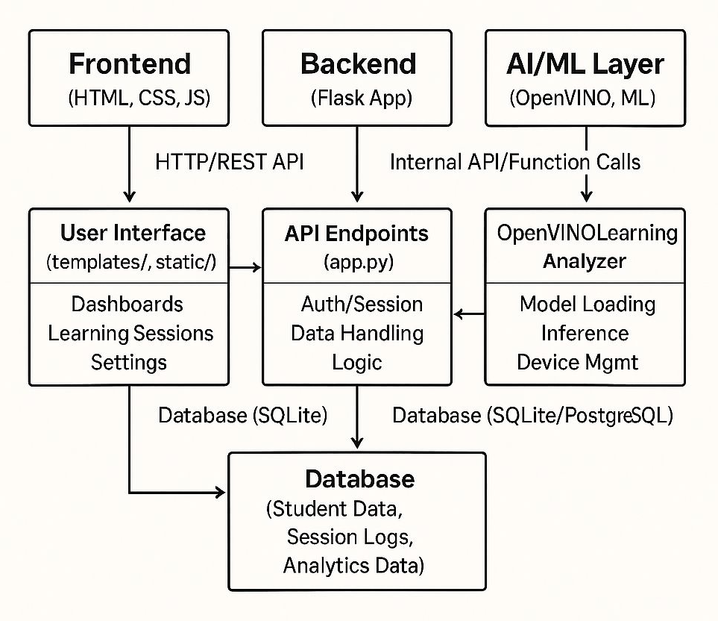
Application Architecture: A Modular Design NeuroLearn's architecture is designed for clarity, scalability, and maintainability, separating concerns into logical components.

Slide 6
ADVANTAGES
Increased efficiency for educators
Improved student outcomes
24/7 learning support
Attendance tracking
Reduced learning gaps

Slide 7
APPLICATIONS
Smart content creation
Real time feedback
Practice and assessments
Used in data driven decision making

Slide 8
CONCLUSION
NeuroLearn represents a significant leap forward in the realm of educational technology. By meticulously integrating cutting-edge artificial intelligence, particularly through the efficient inference capabilities of Intel's OpenVINO toolkit, the platform addresses the long-standing challenge of providing truly personalized education. NeuroLearn is more than just a piece of software; it is a commitment to a more equitable, engaging, and effective educational future. By harnessing the power of AI, we aim to unlock the full potential of every student, transforming the traditional classroom into a smart, adaptive, and truly personalized learning space.

Slide 9
THANK YOU

